Slide 1
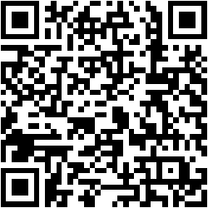
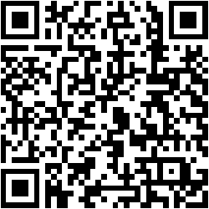

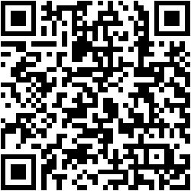
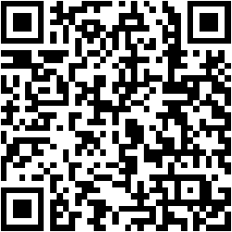
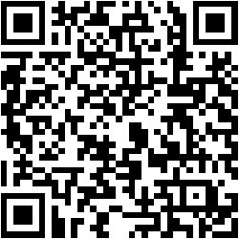
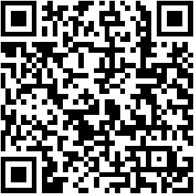
Scan me to visit this poster in Gather.town
Scan me to visit this poster in Gather.town
Position: A1
Position: A2
Scan me to visit this poster in Gather.town
Scan me to visit this poster in Gather.town
Position: B1
Position: B2
Scan me to visit this poster in Gather.town
Scan me to visit this poster in Gather.town
Position: C1
Position: C2

